Slide 1


Machine learning for intrusion detection using CIC-IDS2017
Presented by
Ruturaj Jayant Kotwal
Advait Santosh Lanjekar
Guide
Prof. Dr. Christian Groth

Slide 2







Device Security
CCTV
Secure Payment
Computer Security
Fingerprint
Global Security

Slide 3
Use of Multilayered Perceptrons in IDSs
Identify complex patterns in network traffic.
Generalize to new attack patterns by learning representations of both normal and malicious activity.
Achieve high accuracy when trained on a well-prepared dataset, with the potential to reduce false positives.

Slide 4
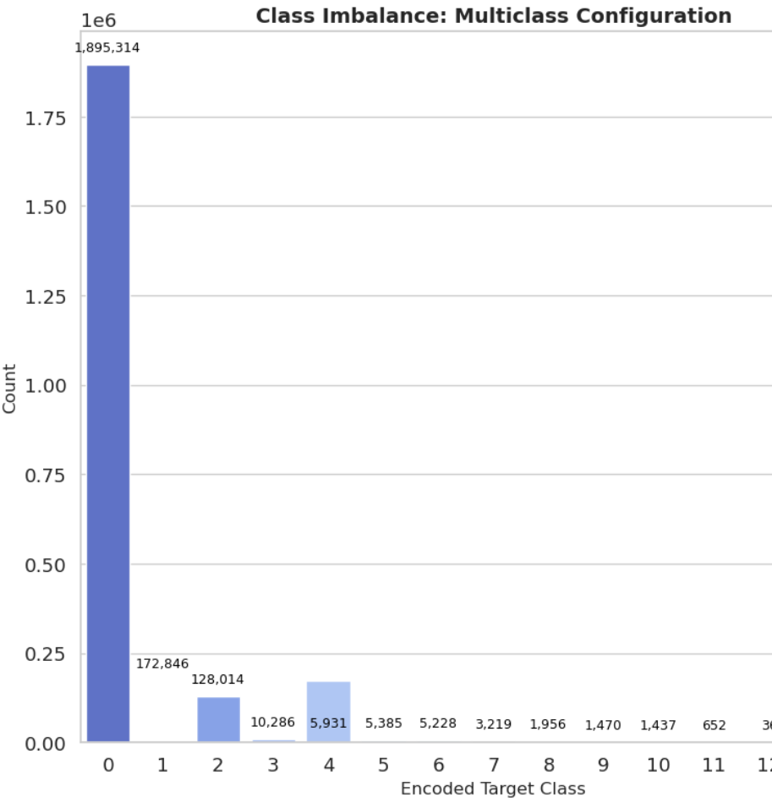
CIC-IDS2017
Real-world traffic, including benign and updated attack types (e.g., brute force, DDoS, botnet attacks).
80 network traffic features extracted with CICFlowMeter.
Significant class imbalance was observed, with benign traffic comprising 84.92% of the binary dataset.

Slide 5
Data Preparation
Splitting the data
Feature Selection with XGBoost
Feature Engineering
Exploratory Data Analysis
SMOTE
Training (75%), Validation (10%), Test (15%).
Stratified splitting to maintain class distribution.
Reproducibility ensured via fixed random seed and dataset shuffling.

Slide 6
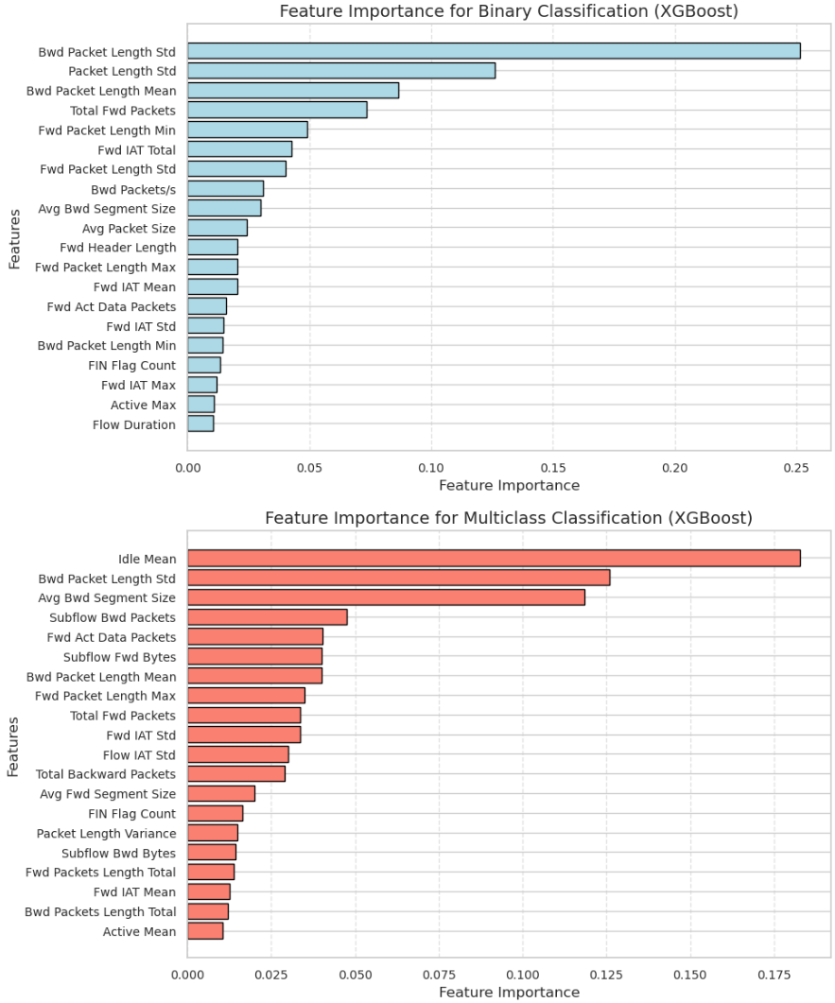
Splitting the data
Feature Selection with XGBoost
Feature Engineering
Exploratory Data Analysis
SMOTE

Slide 7
Splitting the data
Feature Selection with XGBoost
Feature Engineering
Exploratory Data Analysis
SMOTE
Purpose: Enhance model performance by transforming raw data.
Focus: Applied to binary classification after feature selection.
New features:
Combined importance: Weighted sum of related features.
Ratios & Differences: Differences between related features (e.g., packet lengths).
Interaction features: Product of features (e.g., Bwd Packets/s × Flow Duration).

Slide 8
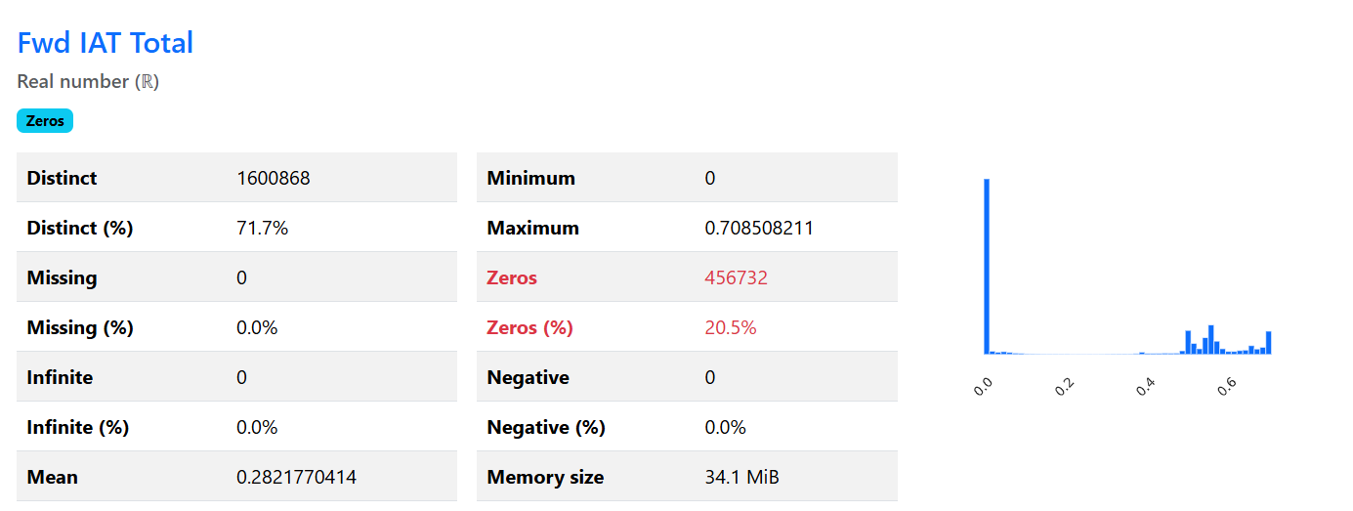
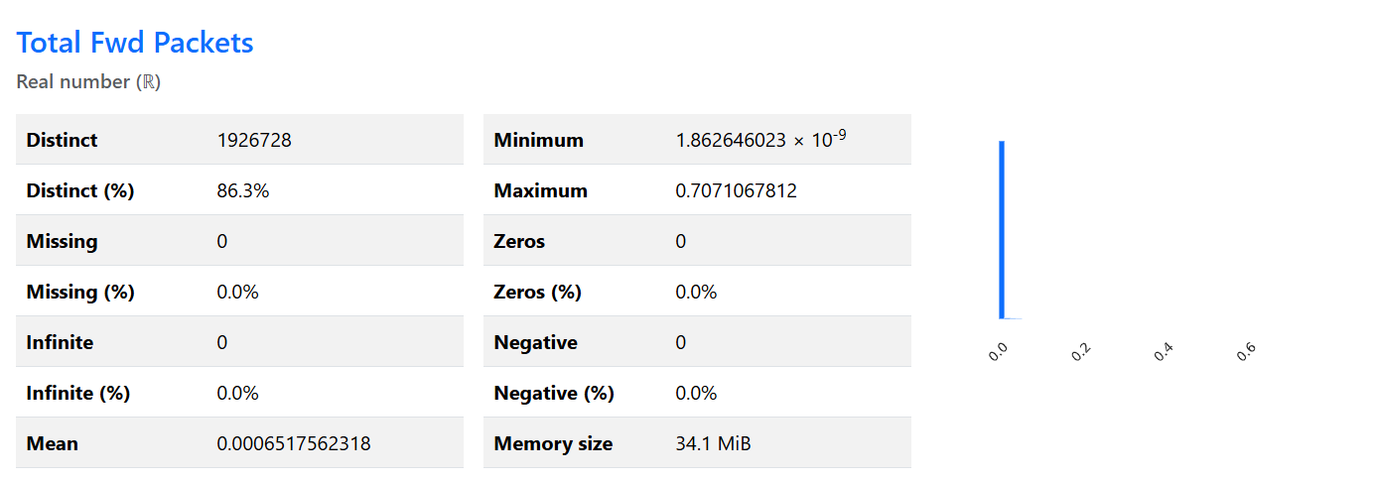
Tool: ProfileReport module from the ydata_profiling library.
Focus: Limited to the final 20 features after feature selection and engineering.
Splitting the data
Feature Selection with XGBoost
Feature Engineering
Exploratory Data Analysis
SMOTE

Slide 9

Sampling ratio: 0.5 (minority class size = 50% of majority class).
Applied only to training set to prevent data leakage.
Assumes synthetic data represents true minority class complexity.
May miss nuanced minority class patterns.
Splitting the data
Feature Selection with XGBoost
Feature Engineering
Exploratory Data Analysis
SMOTE
https://www.youtube.com/watch?v=NvrfSntsm7w

Slide 10
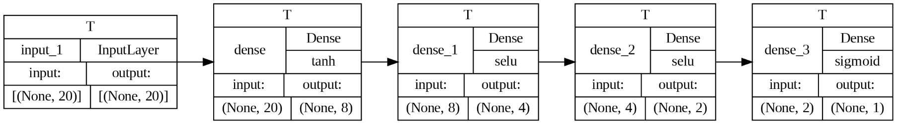
Binary Classification
Overview of Models
Five MLP models ranging from minimal to maximal complexity.
Minimal (Model 1): 4 layers, 8-2 units, low memory usage.
Maximal (Model 5): 9 layers, 256-2 units, high accuracy.
Training Details
Optimizer: Adam with binary cross-entropy loss.
Early Stopping: Stops after 8 epochs of no validation improvement.
Learning Rate: Dynamically adjusted.
Batch Size: Best performance at 1024.
Visualization of model_1_b

Slide 11
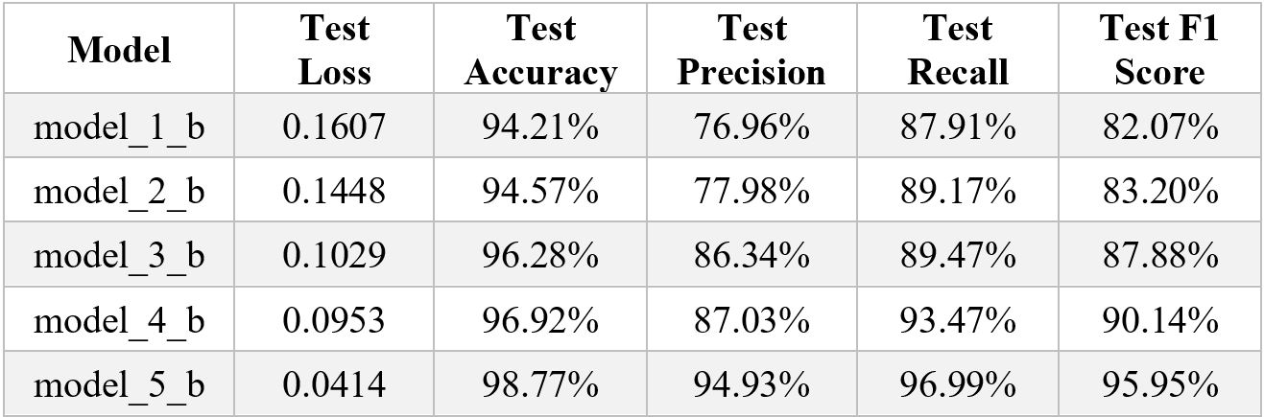
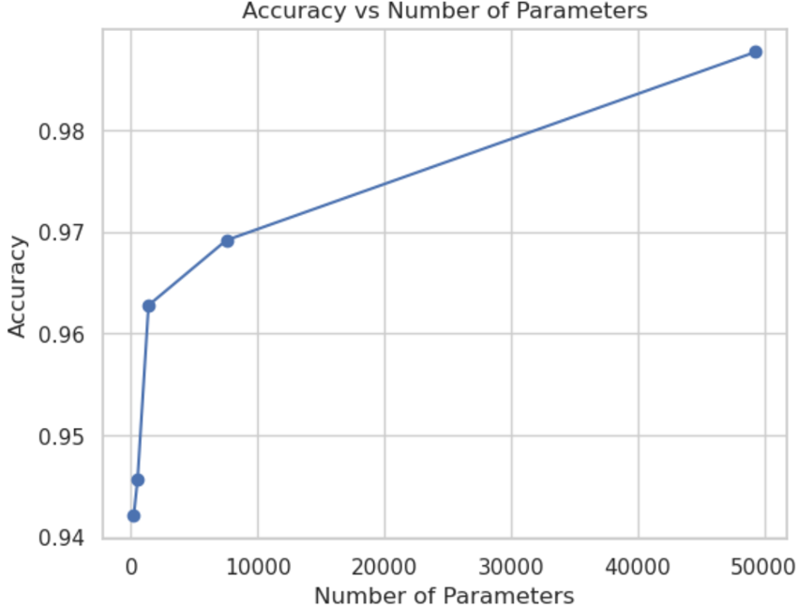
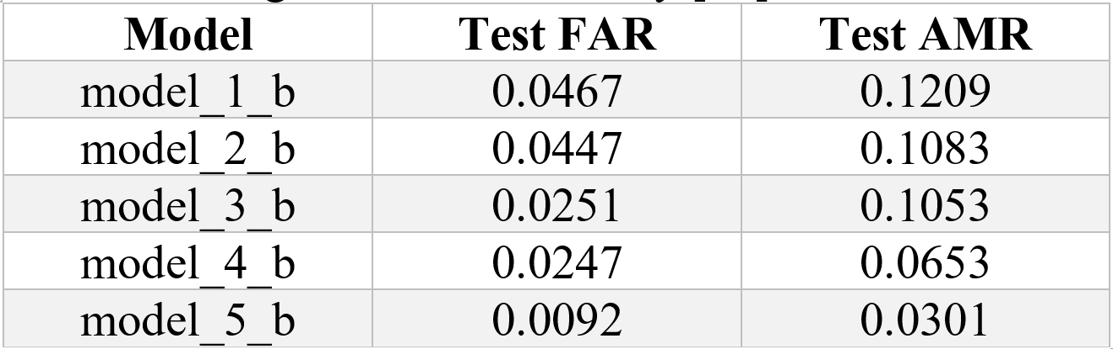
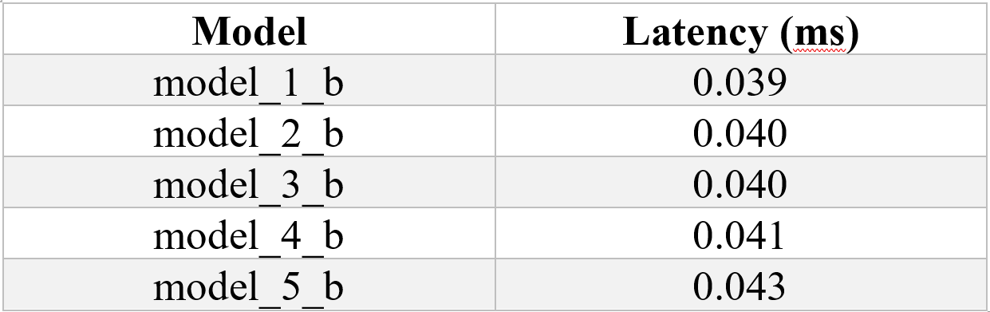

Slide 12
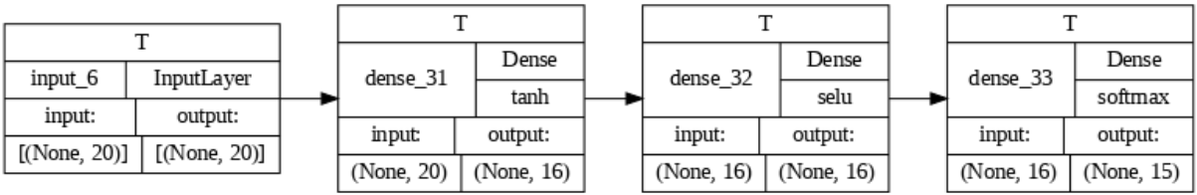
Multiclass Classification
Model Overview:
Model_1_m (Minimal): 3 layers, 863 parameters.
Model_2_m: Adds 1 hidden layer, 1,135 parameters.
Model_3_m: 3 hidden layers, 1,407 parameters.
Model_4_m: 4 hidden layers, 1,679 parameters.
Model_5_m (Maximal): 5 hidden layers, 5,391 parameters.
Design Highlights:
Activations: Tanh and SELU with softmax output.
Scalability: Balances complexity and performance, using a similar process as binary classification.
Visualization of model_1_m

Slide 13
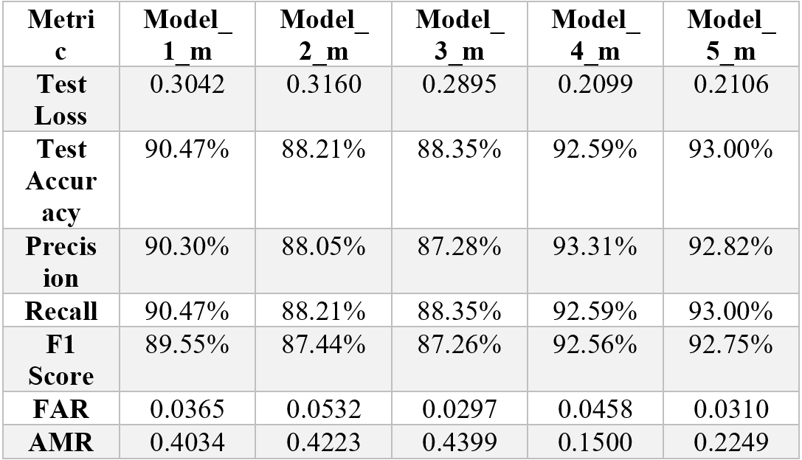
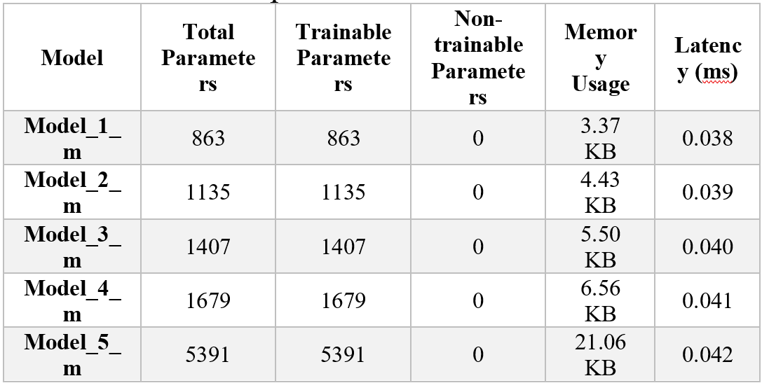
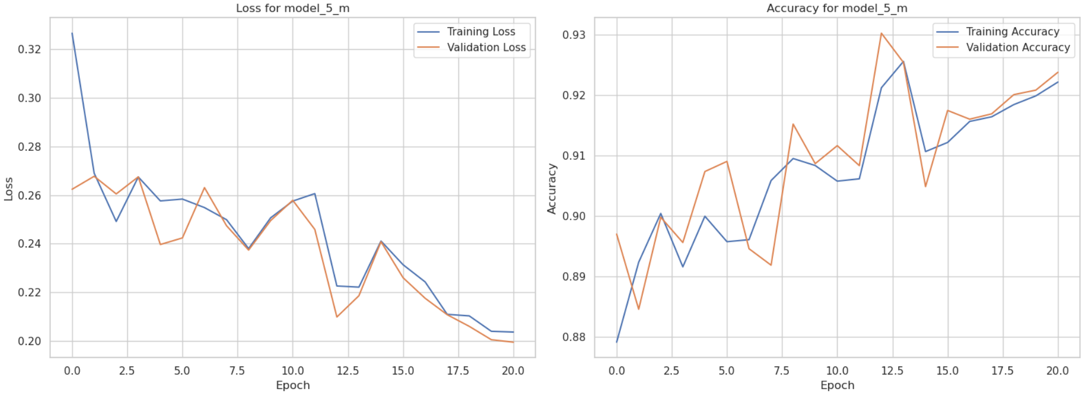
Training and Validation Loss & Accuracy over epochs for model_5_m

Slide 14
Future Outlook
Scaling Techniques: Normalize input data to enhance generalization.
Outlier Analysis: Remove noise and anomalies for improved preprocessing.
Explainable AI (XAI): Provide insights into model decisions. Increase trust and interpretation by cybersecurity experts.

Slide 15
Conclusion
Best Performance: Model_5_m achieves 93.00% accuracy with the lowest FAR (0.0310) and AMR (0.2249).
Efficiency: Maintains low latency (0.042 ms), despite higher memory usage.
Recommendations:
Model_5_m: Ideal for precision-focused systems prioritizing accuracy and recall.
Model_1_m: Lightweight alternative for resource-constrained environments.

Slide 16
References
Echeta, I., 2024. Development of an Intrusion Detection System Using Multilayer Perceptron. https://easychair.org/publications/preprint/HzQKH/open
Talukder, M.A., Islam, M.M., Uddin, M.A. et al. Machine learning-based network intrusion detection for big and imbalanced data using oversampling, stacking feature embedding and feature extraction. J Big Data 11, 33 (2024). https://doi.org/10.1186/s40537-024-00886-w
Iman Sharafaldin, Arash Habibi Lashkari, and Ali A. Ghorbani, “Toward Generating a New Intrusion Detection Dataset and Intrusion Traffic Characterization”, 4th International Conference on Information Systems Security and Privacy (ICISSP), Portugal, January 2018.
Habibi Lashkari, Arash. (2018). CICFlowmeter-V4.0 (formerly known as ISCXFlowMeter) is a network traffic Bi-flow generator and analyser for anomaly detection. https://github.com/ISCX/CICFlowMeter. 10.13140/RG.2.2.13827.20003.

Slide 17


